Slide 1


The Effects of Climatic Trends, Variability, and Rates of Change On Mammalian Brain Evolution
BRIAN SCHILDER
The George Washington University
Center for Advanced Study of Hominid Paleobiology
Department of Anthropology
Notes:
My project is titled ‘The Effects of Climatic Trends, Variability, and Rates of Change on Mammalian Brain Evolution.’

Slide 2
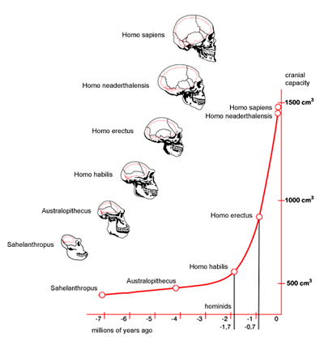
What drove Hominin encephalization?
Ecology?
Tool use?
Meat eating?
Sociality?
Complex social groups?
Climate?
Aridity?
Temperature?
Vegetation?
Adapted from Le Journal du Net (2010)
Notes:
Starting around 2Mya, hominin brain size began to increase dramatically, eventually reaching a cranial capacity over three times as large as the earliest hominins. Many attempts have been made to explain this hallmark of human evolution, by implicating Ecology (regarding the appearance of tools and meat eating), adaptation to life in complex social groups, as well as changes in large-scale climatic factors (such as aridity, temperature, and vegetation). My project focused on investigating the potential roles of Temperature and Vegetation change in brain size increase.

Slide 3
Climate hypotheses
Consistency Selection
Global cooling
Global drying
Increased C4 vegetation
Variability Selection
Increased fluctuations in
temp, aridity, & vegetation
Notes:
As a framework, there are two main categories of Climatic Hypotheses regarding human evolution. This includes Consistency Selection (which focuses on an overall trend towards increased global cooling, aridity, and proportion of C4 vegetation).
In contrast, Variability Selection focuses on increased fluctuations in all of those climatic factors.

Slide 4

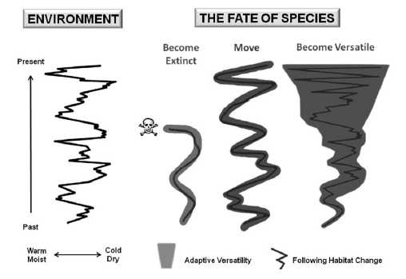
Variability selection Scenarios
Die
Move
Become more “versatile”
Potts (2012)
Notes:
In Variability Selection, there are 3 main options when climatic variability increases dramatically. You can Die (or go extinct), you can move with the habitat you were originally adapted to, OR you can adapt to the changing habitat by becoming more versatile.
One of the proposed means of doing this is by growing a larger brain, which has actually been shown to be a predictor of survival in mammals who are introduced to novel environments.

Slide 5
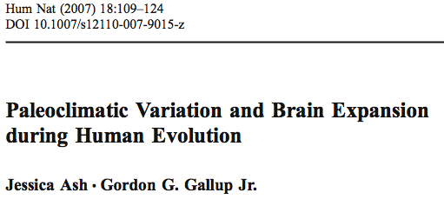
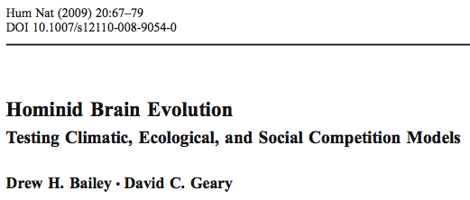

Previous work
But different climatic variables, intervals, and taxa
Notes:
While there have been previous attempts to investigate this in hominins, each of these studies have only tested limited subsets of climatic variables, measures of brain size, and time intervals. Furthermore, none of these studies have included a wide sample other mammalian taxa to see if climate can select for larger brains as a general principle.
I decided to address this by looking across a wide variety of factors and mammalian taxa.

Slide 6
VARIABLES
Notes:
First off, my variables.

Slide 7
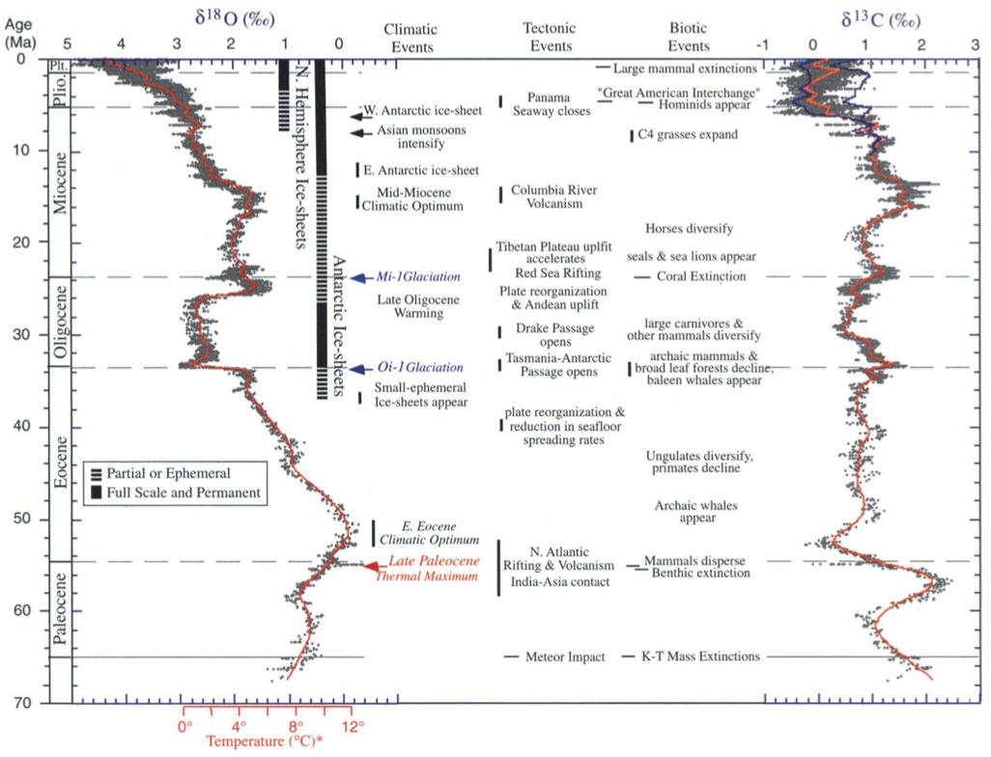
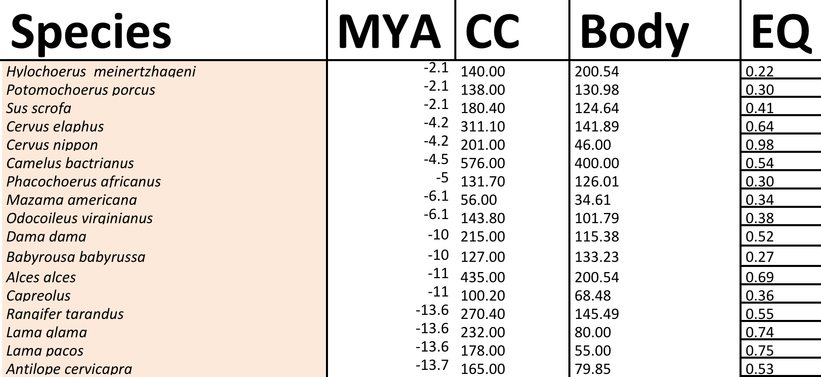
BIOLOGICAL VARIABLES
Climatic VARIABLES
∂¹⁸O = Temperature
∂¹³C = C4/C3 vegetation
Cranial Capacity (CC)
Body Size
Encephalization Quotient (EQ)
Over 65 Million Years
Over 65 Million Years
Shultz & Dunbar (2010): mammals
and Bailey & Geary (2009): hominins
Zachos et al. (2001) dataset
Notes:
My biological variables included Cranial Capacity, Body Size, and Encephalization Quotient for mammals spanning the last 65 million years.
For my climatic variables, I used deep-sea core Oxygen and Carbon isotope records as proxies for global temperature and vegetation change, for those 65 million years.

Slide 8
Climatic measures
Calculated for both ∂¹⁸O and ∂¹³C :
Standard Deviation = Variability
Mean = Trend
Slope = Rate of Change
Notes:
For both temperature and vegetation, I calculated Standard Deviation (as a proxy for Variability), Mean (as a proxy for consistent Trends), and Slope (as a proxy for the Rate of change), the last of which to my knowledge hasn’t been investigated much if at all in this context but I thought it would be interesting to see if speed of climatic change affects brain size.

Slide 9
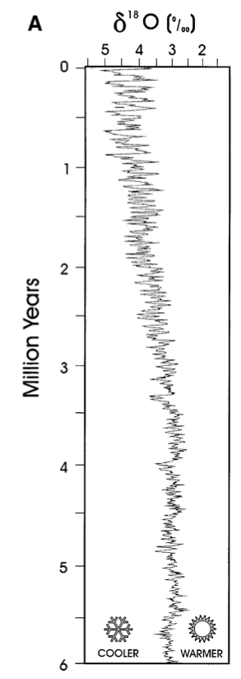
Investigated 6 different time intervals
∂¹⁸O isotopes
5M
1M
400k
200k
100k
40k
Potts (1998)
Notes:
I used 6 different time intervals for each of these measures. These intervals correspond to different periodic orbital cycles of the planet that can force large-scale climate change, including Orbital Obliquity (at 40k) and Orbital Eccentricity (at 100, 200, & 400k). I also included 1My and 5My intervals to try to capture a large number of climatic events per unit.
So for example, if I had a species that appeared at 2Mya, I would correlate that specie’s cranial capacity with all the different climatic variables over the course of 2 - 2.04Mya, then 2 - 2.1Mya, and then repeat for all intervals.

Slide 10
SPECIMENS
Notes:
Ok, so onto my specimens.

Slide 11
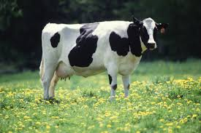
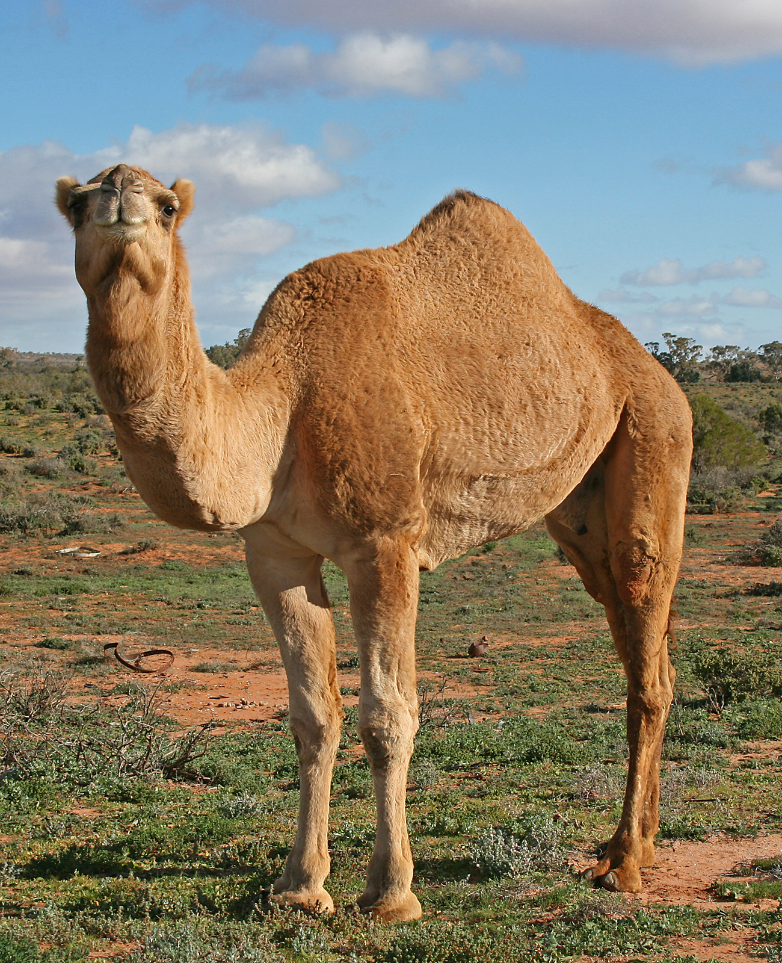
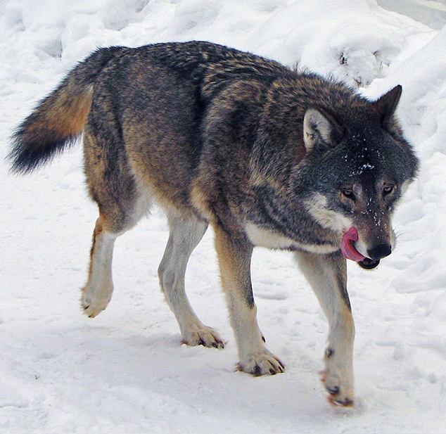
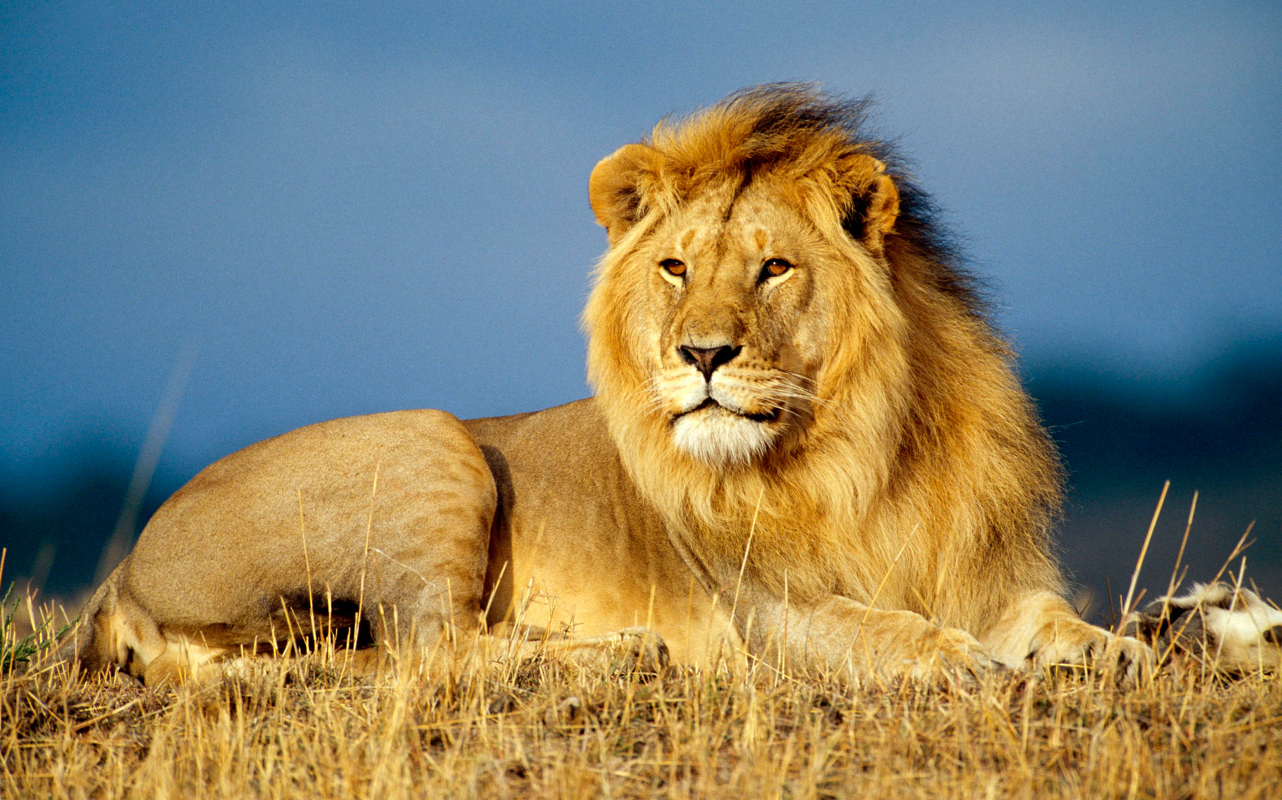
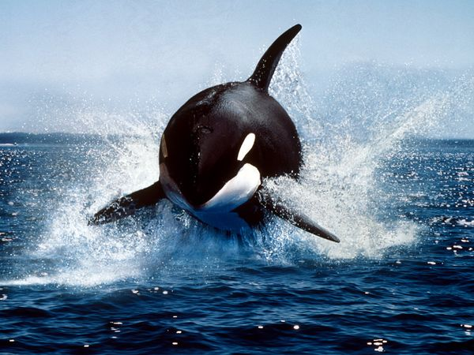
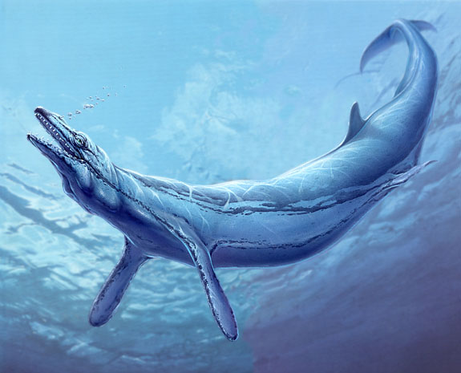
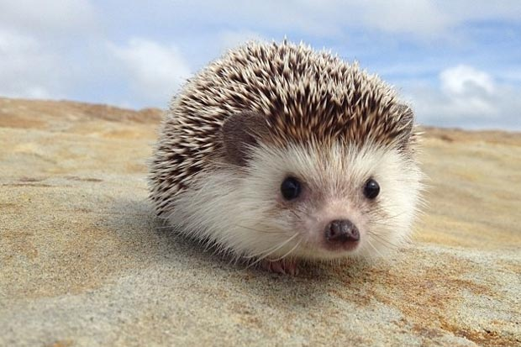
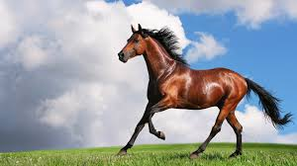
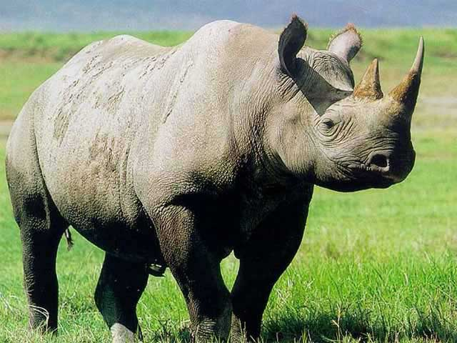
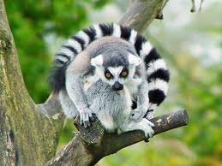
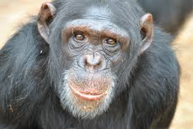
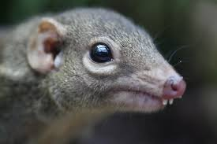
Non-hominin TAXA (N=508 species)
Artiodactyla
(N=45)
Carnivora
(N=290)
Cetacea
(N=58)
Ruminants
Tylopoda
Caniformes
Feliformes
Odontoceti
Archaeoceti
Insectivores
(N=33)
Perissodactyla
(N=24)
Primates
(N=61)
Erinaceomorpha
Scandentia
Hippomorpha
Ceratomorpha
Strepsirrhines
Haplorrhines
Shultz & Dunbar (2010) dataset
Notes:
For my broader extant and extinct mammalian sample, I used Shultz & Dunbar’s 2010 dataset which included Artiodactyls, Carnivores, Cetaceans, Insectivores, Perissodactyls, and Primates, for a total of 508 different species over the course of the last 65My.

Slide 12
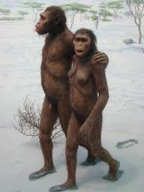
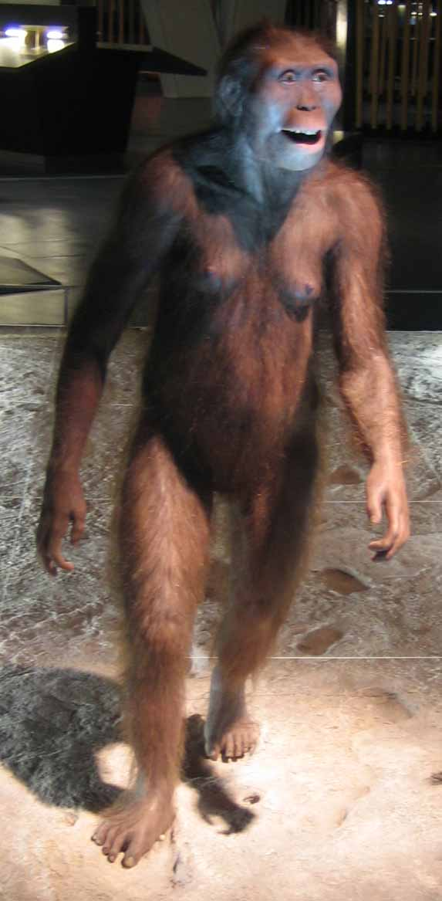
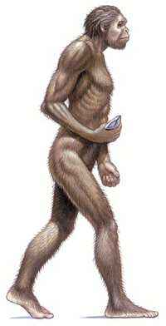

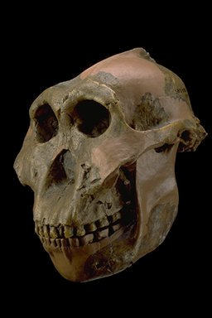
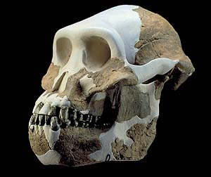
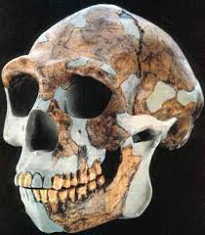
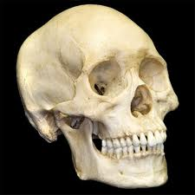
Hominin taxa
(N=175 individuals, 11 species)
Australopithecus
Paranthropus
Pre-modern Homo
Modern H. sapiens
Bailey & Geary (2009) dataset
Notes:
My Hominin sample included 11 species over the last 3.2My, including those from the genera Australopithecus, Paranthropus, and Homo.

Slide 13
RESULTS

Slide 14

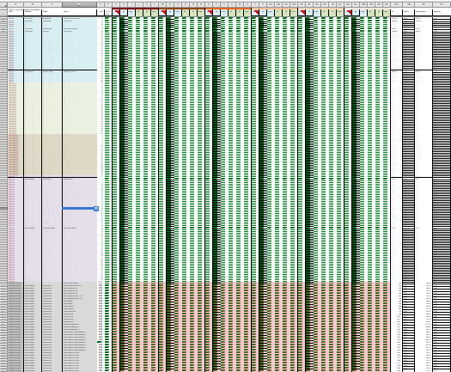
Total Comparisons
24,588 calculated climatic measures (∂¹⁸O & ∂¹³C, all 6 intervals)
98,352 comparisons (biological x climate & time)
Notes:
I started by calculating climatic measures for each of the taxa, and then running them through about 100,000 total bivariate correlations.

Slide 15
Correlations: Orders
756 correlations
Bonferonni correction: α = .000
0.0000
= Significant at P < .000
Notes:
Of those I extracted the most relevant ones for both Orders

Slide 16
Correlations: Suborders
864 correlations
Bonferonni correction: α = .000
0.0000
= Significant at P < .000
Notes:
….and Suborders.

Slide 17
Correlations: Hominins
36 correlations
Bonferonni correction: α = .000
0.0000
= Significant at P < .000
Notes:
And for Hominins.

Slide 18
So…..now what?.....

Slide 19
Composite Score
Climatic Response Profile (CRP)
= The sum of all Rho values of CC vs. Climate Variable (∂¹⁸O + ∂¹³C), across all time intervals
Proxies for CC responsiveness to Variability (SD), Trend (Mean), and Rate of Change (Slope)
Notes:
For the purposes of this presentation, I’m just going to focus on my results for Cranial Capacity.
In an attempt to interpret this data, I created a composite score I call a Climatic Response Profile; which is the sum of the correlation coefficients of ‘Cranial Capacity vs. Temperature’, and ‘Cranial Capacity vs. Vegetation’, then aggregated across all time intervals. I used this as a way to quantify the responsiveness of Cranial Capacity to climatic Variability, Trend, and Rate of Change.

Slide 20
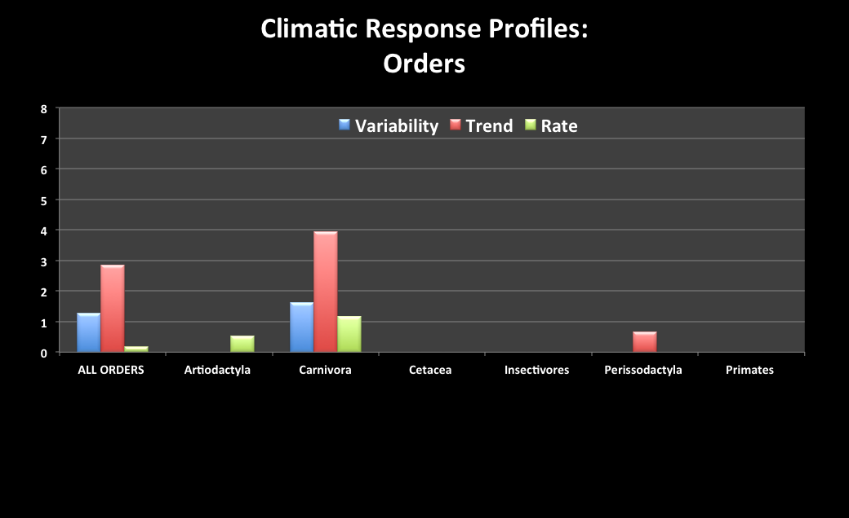
Mammals overall appear responsive to Variability & Trend
However subdividing by Order reveals varying contributions
Carnivora are most responsive (esp. Trend)
Notes:
If we were just look at mammals as a whole, we might conclude that brain size is responsive to Variability and Trend, but not Rate. However, it’s actually much more informative to break mammals into Orders to figure out who is contributing to these values. Indeed, we find very different Climatic Response Profiles for each of these taxa, with Carnivores bring the most responsive in general.
Others appear to contribute nothing at all, which is perhaps surprising for the very encephalized non-human primates.

Slide 21
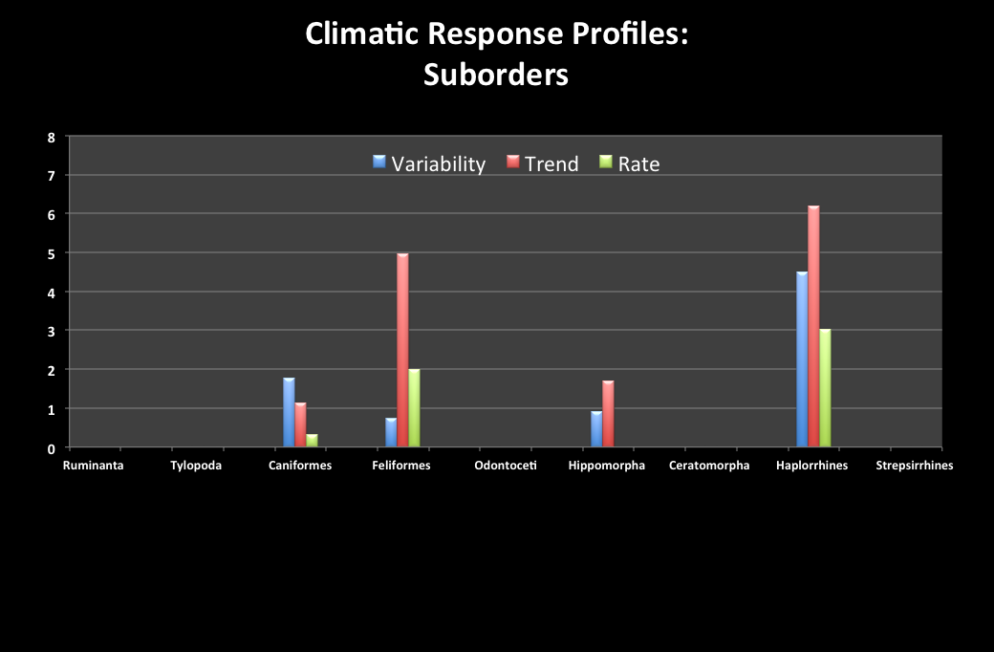
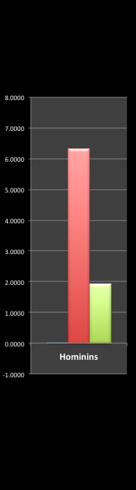
Feliformes (Trend) & Haplorrhines (Variability, Trend & Rate)
Intermediate to Feliformes & Haplorrhines in responsiveness to Trend & Rate
Hominins show NO responsiveness to Variability
Notes:
However, by breaking these Orders even further into Suborders, we find a different story.
Within primates, Haplorrhines are actually extremely responsive to Variability, Trend, AND slope. It’s just that the Strepsirrhines were bringing them down below significance.
When taxa are compared to Hominins, we find that Hominin brain size is very responsive to Trend and somewhat to Rate.

Slide 22
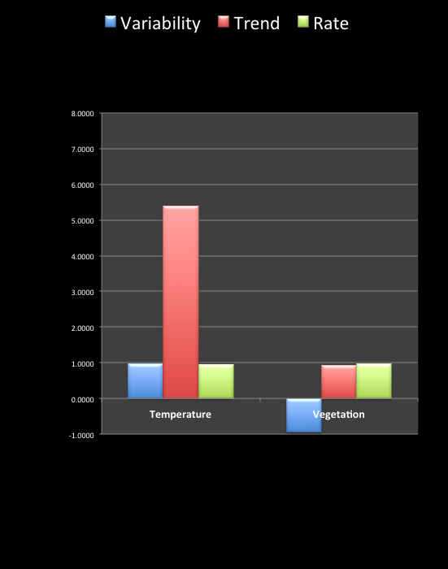

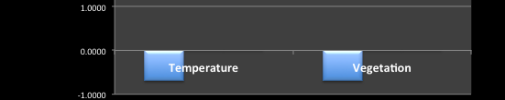
CARNIVORA
Hominins are highly responsive to a cooling Trend
Slight responsiveness to Variability, but negative for Vegetation
Carnivora are slightly negatively responding to Variability in the last 3.2Mya
Notes:
I then broke up the Hominin Climatic Response Profile to look more closely at the effects of Temperature vs. Vegetation.
I found that Hominins are actually very responsive to Global Cooling, and only slightly to Global Temperature Variability, and Speed of Change.
Furthermore, Vegetation only seemed to have a mild effects, with Vegetation Variability actually decreasing brain size a bit.
When I compared Hominins to Carnivores within just the past 3.2My, I found that the two taxa were actually very dissimilar. In general, over the past 65My Carnivore brain size has been responsive to cooling like Hominins, but it just hasn’t been responsive in the last 3.2My like that of Hominins. Suggesting that other large-scale or small-scale factors influence how brains evolve besides global temperature and vegetation, which makes sense since these factors can’t be expected to account for all of brain evolution. Rather, in the right evolutionary conditions, they can be drivers of brain growth.

Slide 23
Main Conclusions
Climatic Variability, Trend, & Rate can all drive brain growth, but not necessarily for all taxa at every point time
Looking across all 65My, when mammals do respond to Variability, it’s always with brain size increase (not decrease)
Hominin, Carnivore, and Haplorrhine brains responded to all 3 measures, but mostly to a Trend in global cooling

Slide 24
Acknowledgements
Brian Richmond & Bernard Wood
Chet Sherwood
René Bobe
John Kingston
References
Potts, R. (2012). Environmental and Behavioral Evidence Pertaining to the Evolution of Early Homo. Current Anthropology, 53(S6), S299–S317. doi:10.1086/667704
Ash, J., & Gallup, G. G., Jr. (2007). Paleoclimatic Variation and Brain Expansion during Human Evolution. Human Nature, 18(2), 109–124. doi:10.1007/s12110-007-9015-z
Bailey, D. H., & Geary, D. C. (2009). Hominid Brain Evolution. Human Nature, 20(1), 67–79. doi:10.1007/s12110-008-9054-0
Shultz, S., & Maslin, M. (2013). Early Human Speciation, Brain Expansion and Dispersal Influenced by African Climate Pulses. PloS One, 8(10), e76750. doi:10.1371/journal.pone.0076750.s001
Shultz, S., & Dunbar, R. (2010). Encephalization is not a universal macroevolutionary phenomenon in mammals but is associated with sociality. Pnas, 107(50), 21582–21586. doi:10.1073/pnas.1005246107
Zachos, J., Pagani, M., Sloan, L., Thomas, E., & Billups, K. (2001). Trends, rhythms, and aberrations in global climate 65 Ma to present. Science, 292(5517), 686–693.
Potts, R. (1998). Environmental hypotheses of hominin evolution. American Journal of Physical Anthropology, Suppl 27, 93–136. doi:10.1002/(SICI)1096-8644(1998)107:27+<93::AID-AJPA5>3.0.CO;2-X
Notes:
Lastly I’d like to thank Other Brian, Bernard, Chet, Rene, and John Kingston for their incredibly valuable feedback and direction throughout this project.

